Slide 1
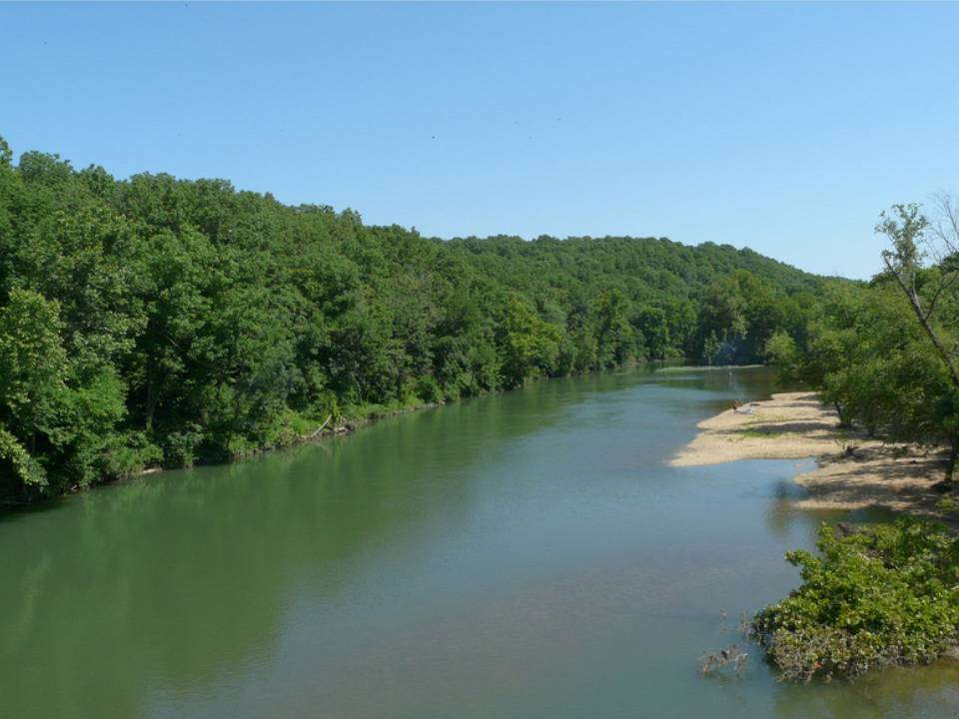
Water Quality Trends across 319 Monitoring Sites
Brian E. Haggard
Director, Arkansas Water Resources Center
Funding provided by ANRC

Slide 2
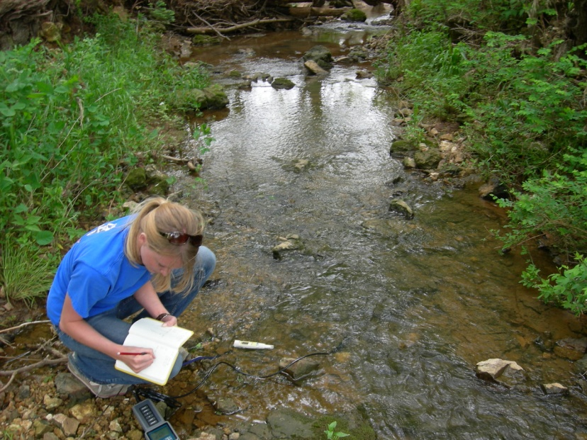
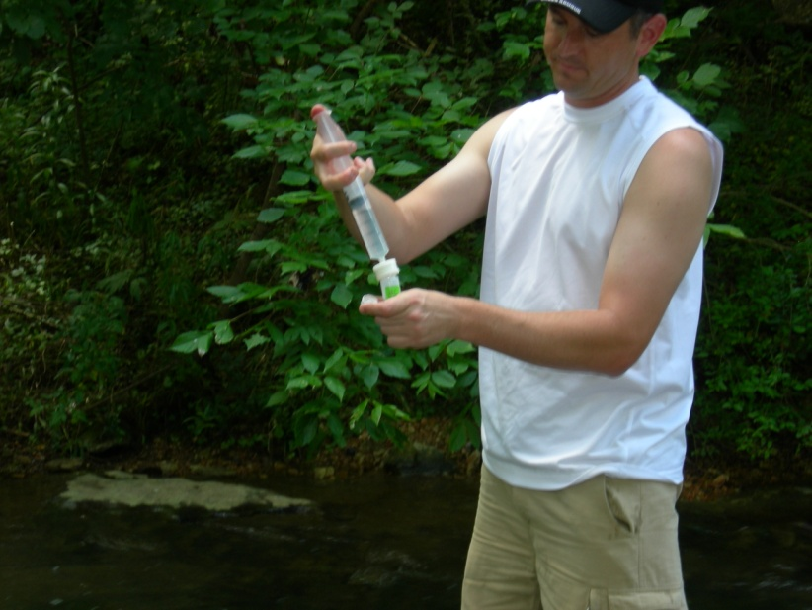
Identifying Water Quality Trends
The objective of this project is to evaluate changes in water quality, where we can…
  Identify the effects of management actions (e.g., proper riparian buffers)
  Identify the effects of new pollutant sources (e.g., new WWTP)

Slide 3
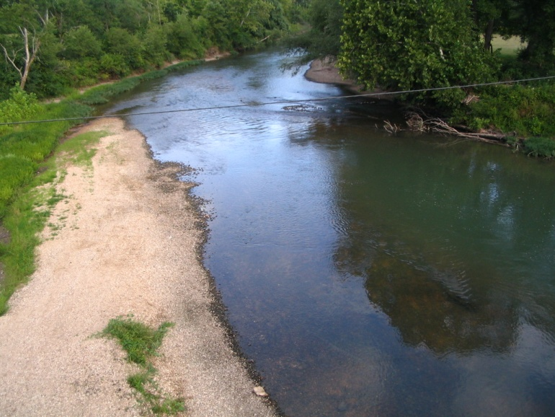
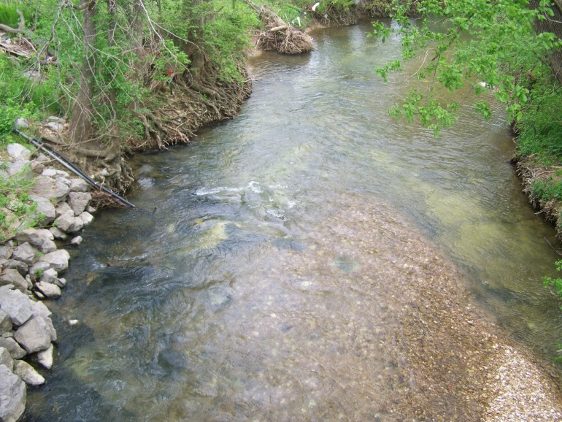
The selected sites were from the 319 monitoring program in northwest Arkansas
Upper Illinois River Watershed
  Ballard Creek
  Osage Creek
  Illinois River
Upper White River Basin
  West Fork White River
  White River
  Kings River

Slide 4
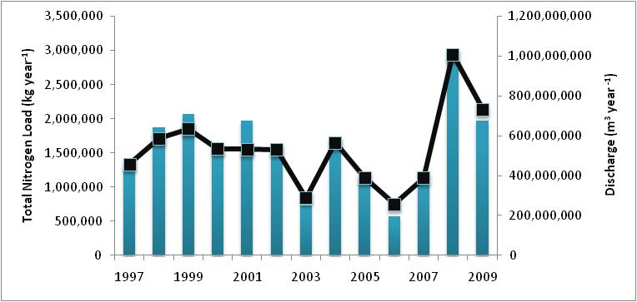
But, evaluating change in water quality is not as simple as looking at the increase or decrease in loads…
Illinois River at Arkansas HWY59

Slide 5
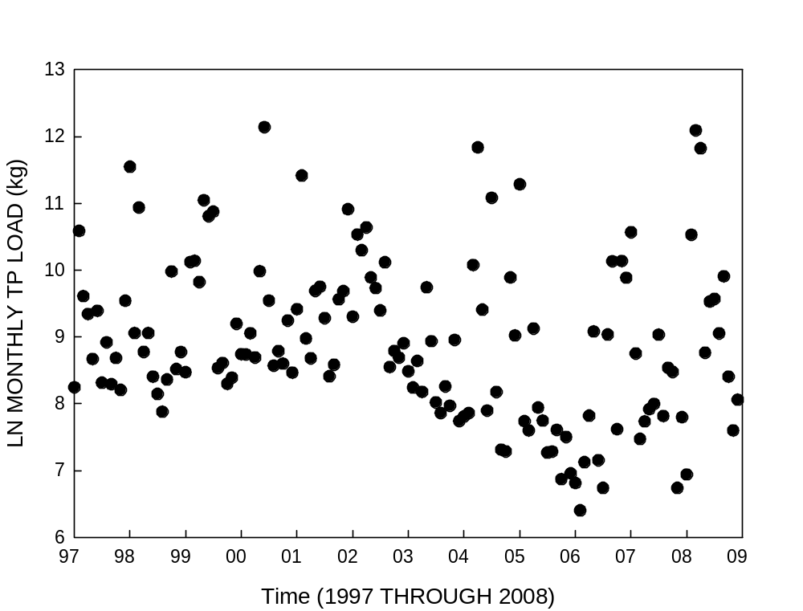
Loads are influenced by precipitation and runoff patterns over time…
You need to remove the influence of stream discharge on loads to identify true trends in water quality.

Slide 6
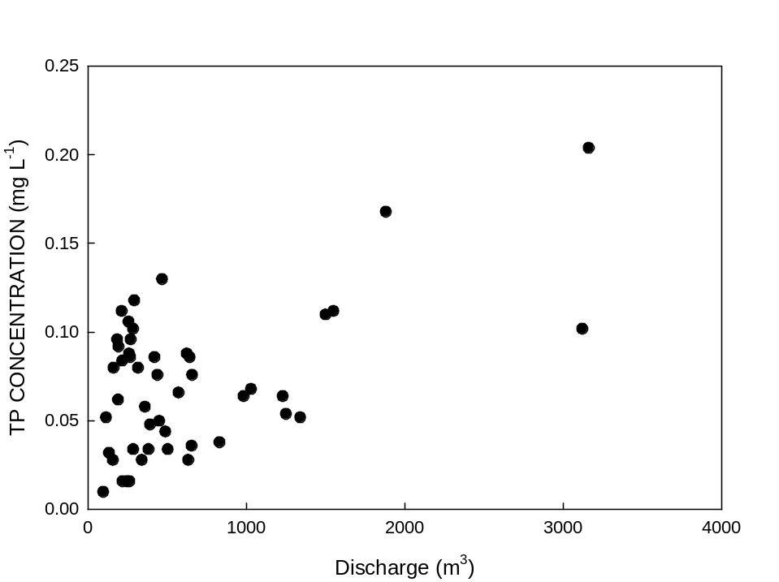
Concentrations also change with increasing discharge…
You need to remove the influence of stream discharge on loads to identify true trends in water quality.

Slide 7
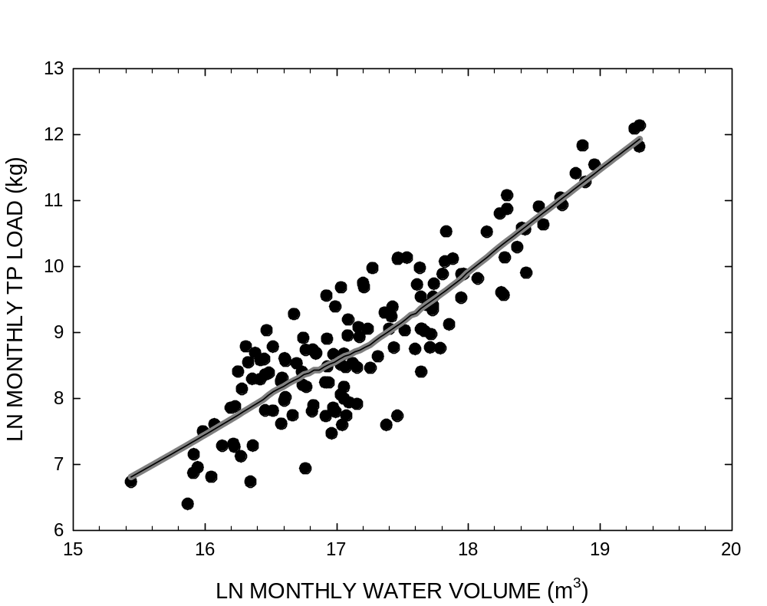
Removing the influence of discharge…
A curve is fit to the data that best represents how things change with discharge…
The next step is to determine the residual.

Slide 8
The residuals represent the flow-adjusted loads or concentrations…
Then, we look at how these adjusted values change over time…
That’s how we identify trends in water quality.

Slide 9
Flow-adjusted loads or concentrations are relative to the line, or expected…
These values are greater than the typical value at a given discharge.
These values are less than the typical value at a given discharge.

Slide 10
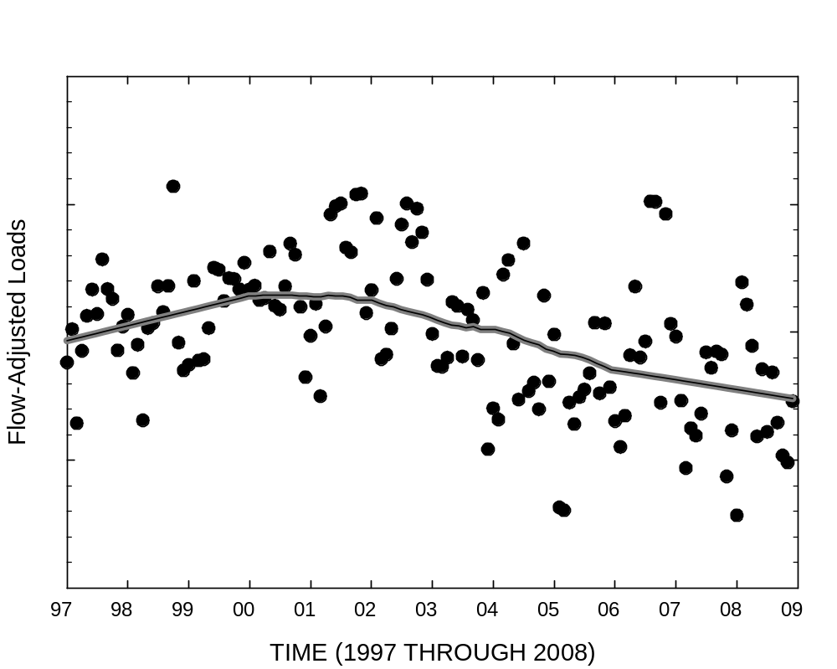
The residuals are plotted over time to determine if flow-adjusted values are increasing or decreasing over time…

Slide 11
These flow adjusted loads are from the Illinois River at Arkansas HWY59…
Something happened in 2002…

Slide 12
It’s important to have long term monitoring at sites to know what’s going on…
You need to have a relatively, consistent monitoring program:
  Consistency in the number of samples collected
  Consistency in the parameters analyzed
  Consistency in the program design
We probably need five years of data with consistency…

Slide 13
Where we are now:
Project extension was granted so that we could include data from 2009.
To date, all databases have been compiled, including sampling date, constituent concentration and respective discharge measurements.
Next, we will flow-adjust concentrations and then look at trends over time…

Slide 14
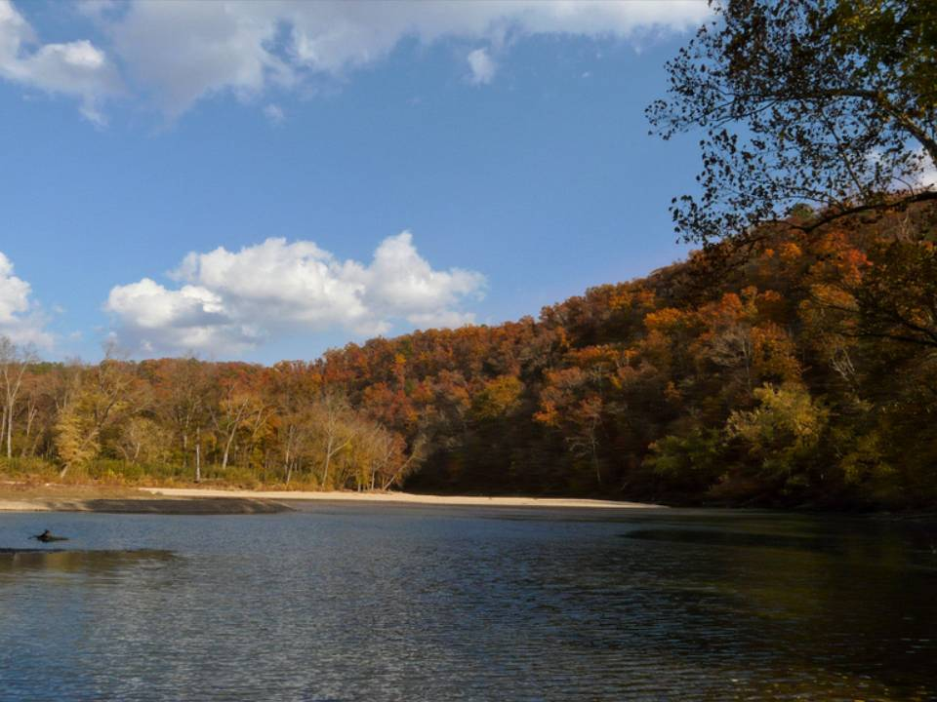
Take Home Message:
Loads are extremely dependent on the variations in discharge, and you need to be remove the effects of discharge to evaluate changes in water quality.
Questions?

